Slide 1
Trigonometric Ratios
Notes:
http://crystalclearmaths.com/wp-content/uploads/2015/11/Icon-Trigonometry.jpg
https://lh6.ggpht.com/CmbtkIvKgfYwxcz7FVR00NdKm1JOOomOKjZz_wP0OKVOfrOCL79w6H_aHZ0S8zYd9w=w300-rw

Slide 2
Sides of a Right Angled Triangle
Notes:
http://images.tutorvista.com/cms/images/67/right-triangle.png

Slide 3
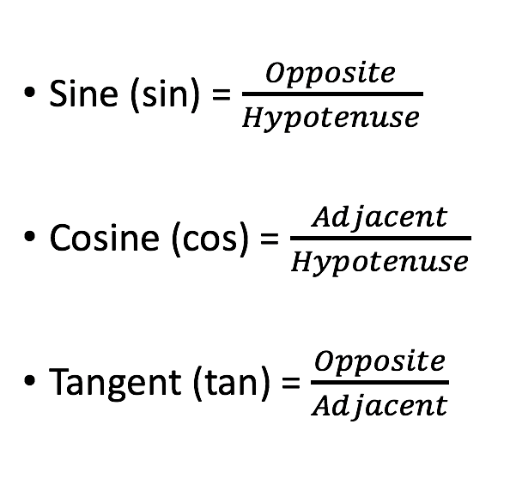
Trigonometric ratios

Slide 4
SOH
CAH
TOA
SOH CAH TOA
Some Old Hags Can Always Hide Their Old Age
Son Of Helen
Can Anyone Help
Try Once Again
Notes:
http://www.mathwarehouse.com/trigonometry/sine-cosine-tangent.php

Slide 5
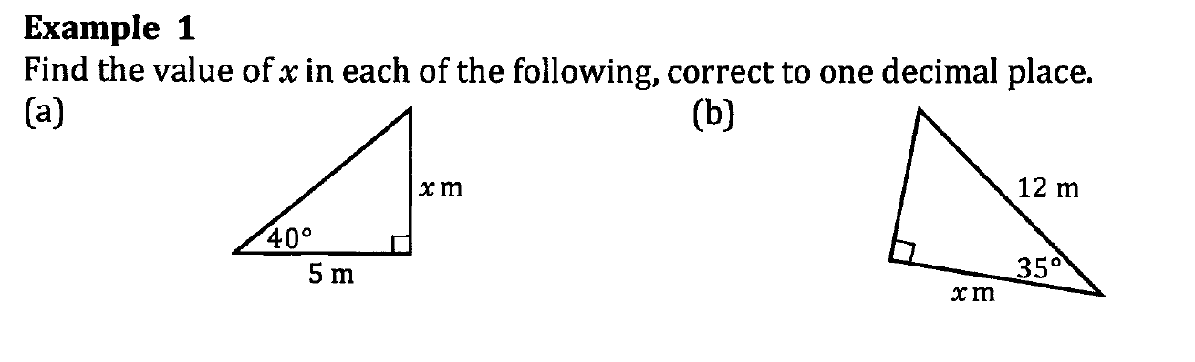












Slide 6
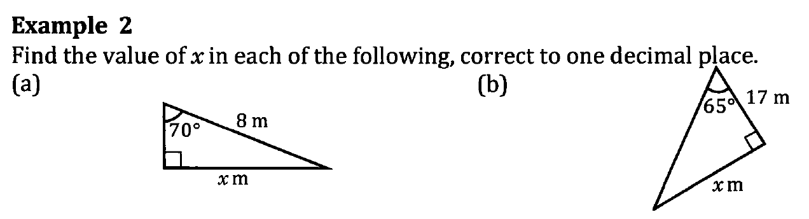











Slide 7
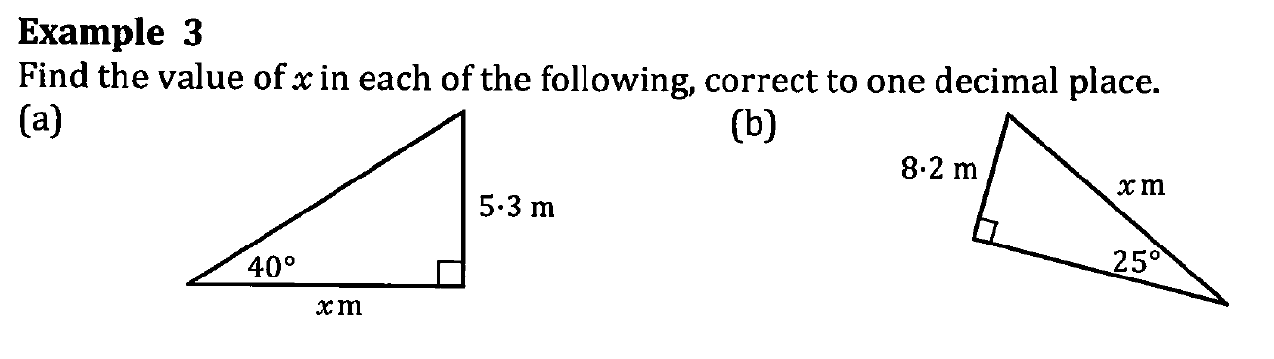










Slide 8
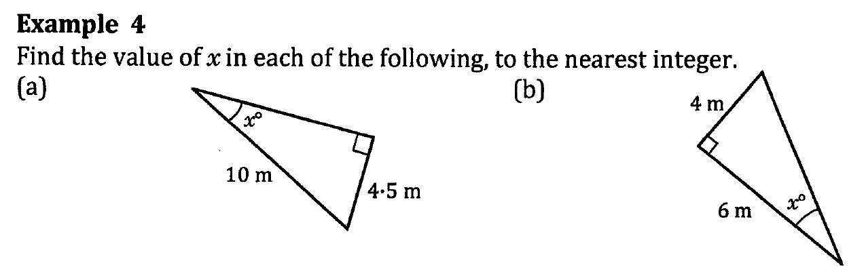













Slide 9
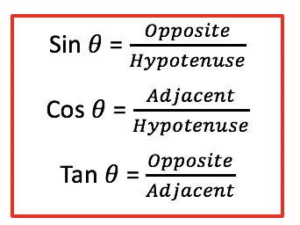
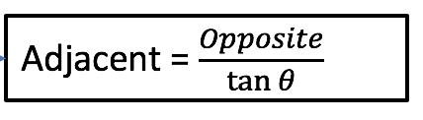
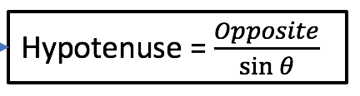

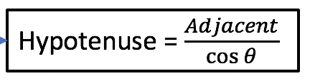


Given angle, $θ$
Determine the sides – opposite, adjacent and hypotenuse
Find ADJACENT
OPPOSITE known
Find HYPOTENUSE
Find OPPOSITE
ADJACENT known
Find HYPOTENUSE
Find ADJACENT
HYPOTENUSE known
Find OPPOSITE

Slide 10
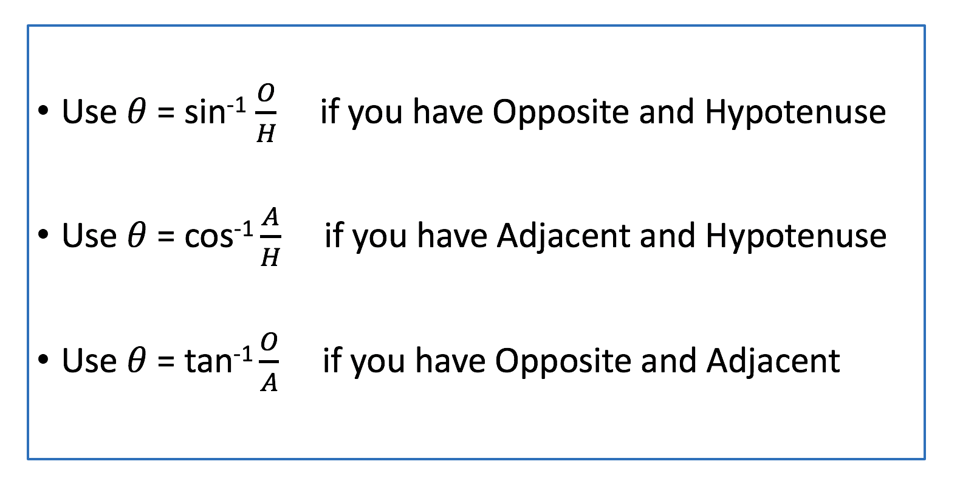
Finding Angles

Slide 11
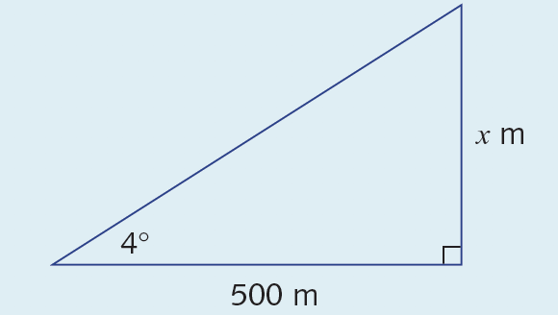








Slide 12
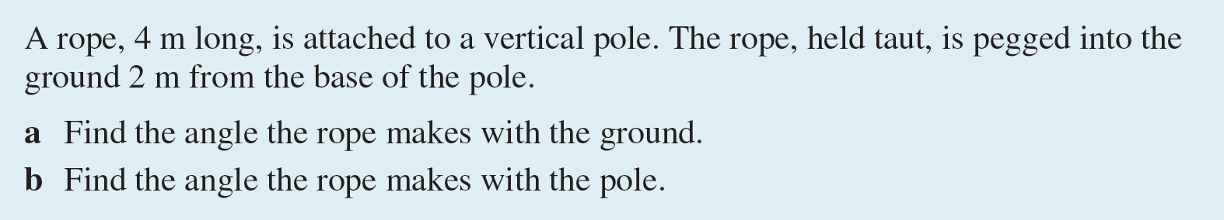
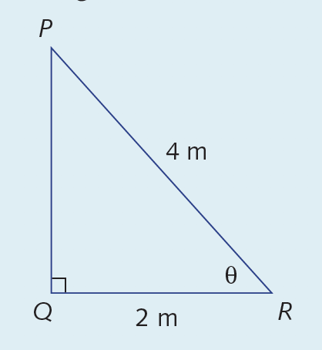















Slide 13
